Slide 1
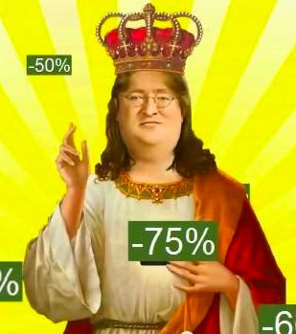
Who is he?
Gabe Newell who secretly “stole” my money in the name of discounts VIA
STEAm

Slide 2

INTRODUCTION
WHAT IS STEAM?
Video game digital distribution service by Valve
Picture it as a vault of games
Contains all kinds of community services
Overall review on games (positive/negative/mixed)
WHY CARE ABOUT REVIEW?
Manufacturers know what to improve
Sales overview based on pre-sale reviews
Additional DLC or music tracks to make profits
Users learn whether it is worthwhile to purchase

Slide 3

How do different game features affect community review?
Wilson Huang
11/12/2020

Slide 4

outline
PREVIOUS STUDIES
DATA OVERVIEW
EDA RESULTS
MODEL
REGRESSION RESULTS
CONCLUSION

Slide 5

Previous studies
Most previous studies are from NLP aspect, studying the games descriptions and review contents
Only a few of the research using logistic regression looked at languages supported
This study recoded discount, dropped outliers which are those weird workshop products, and take languages into account.

Slide 6

DATA OVERVIEW

Slide 7
Variable codebook, June 2019
Continuous Variable | Description
achievements | Number of achievements
original_price | Original price of game in dollar
totalComments | Number of comments
totalLan | Number of languages
discount (discrete) | Percent representation of discount
Remove outliers e.g. Casino Simulator with 5000 duplications
Remove outliers e.g. Euro Truck Bundle priced at $3000
Collapsed into zero, low, and high with benchmark(0 and 0.5)
Categorical Variable | Description
genre | Genre of games
mature_content | Whether it contains blood, sex, etc.
free | Whether it is a free game
multi_player | Whether it supports multi-player
trading_cards | Whether it supports trading_cards
online | Whether it is an online game
controller | Whether it supports controller
cloud | Whether it has cloud backups
Review (response) | Overall positive/negative/mixed
Collapsed into positive and negative only with benchmark(50%)

Slide 8





Explanatory Data Analysis
Categorical variable
more positive with cloud backups
more positive for Adventure and RPG games
more positive with mature_content
more positive if supporting controller
less positive if offered free
more positive if supporting Portuguese

Slide 9
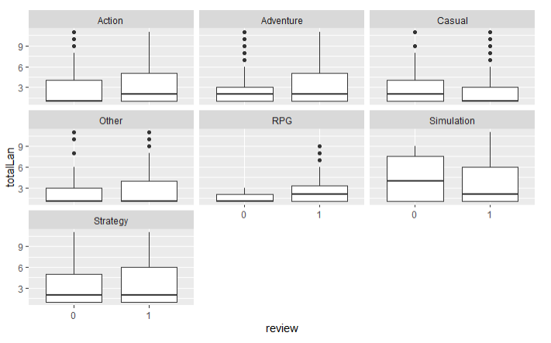
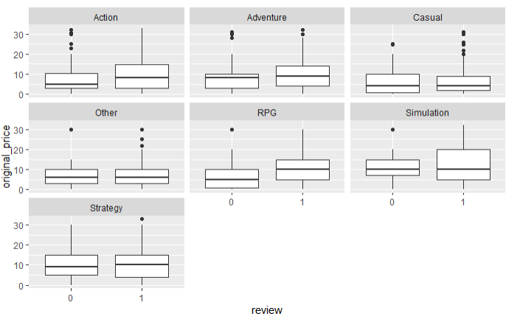
Continuous variable and Interaction
totalLan vs review pattern
varies across different game genre
original_price vs review pattern
varies across different game genre

Slide 10

Model

Slide 11
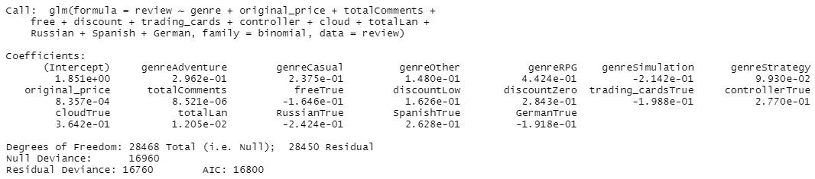
Model selection
Stepwise Selection
Variables Dropped
achievements, mature_content, multi-player, online, Chinese, and Portuguese
Double check with anova chi-square test

Slide 12
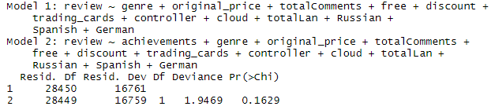
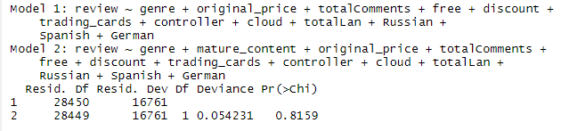
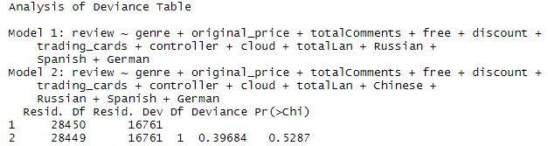
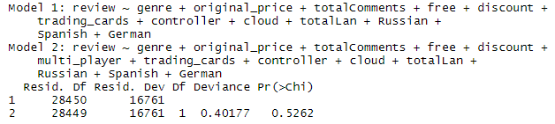
Anova Chi-square Test
achievements
mature
Chinese
multi-player
Indeed!
Anova Chi-square Test confirms it is appropriate to drop those variables.

Slide 13
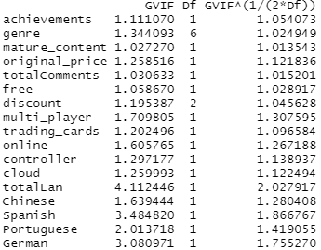
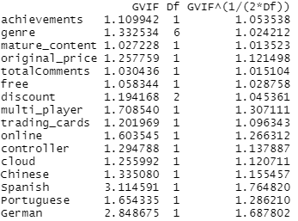
Multicollinearity
Based on anova test and multicollinearity check, drop totalLan

Slide 14
Final model

Slide 15

Regression results

Slide 16
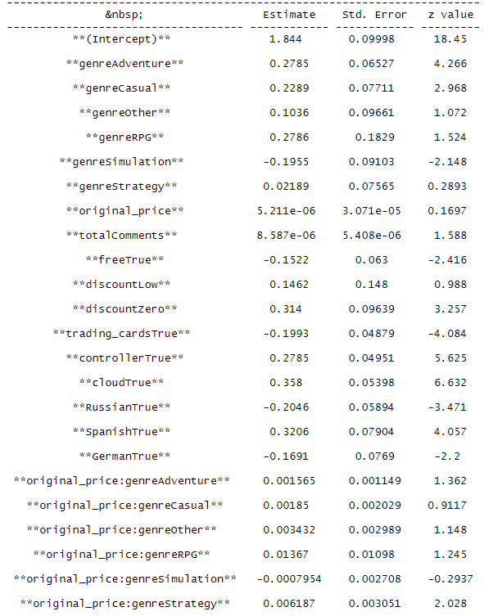
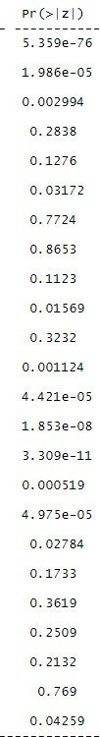
interpretation
Holding other factors constant and under 90% confidence level:
Compared with Action games, the odds of:
Adventure games 23% higher odds
Casual games 39% higher odds
RPG games 45% higher odds
Strategy games 21% higher odds
one unit increase in original price 0.9% higher odds
free games 13% lower odds
zero discount 24% higher odds
trading_cards 20% lower odds
controller 30% higher odds
Russian 20% lower odds
Spanish 37% higher odds
Spanish 16% lower odds
Compared with Action games, one unit increase in original price of:
Simulation games 1.57% lower odds
Strategy games 1.59% lower odds

Slide 17
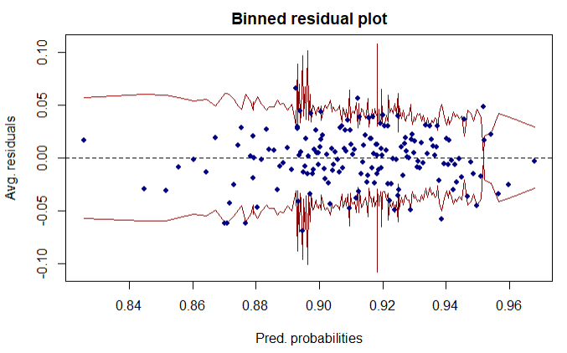
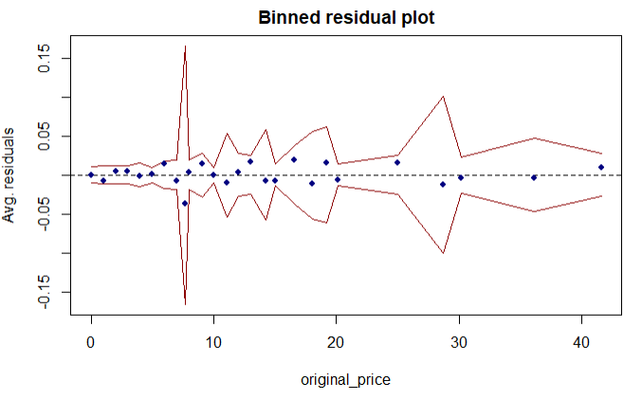
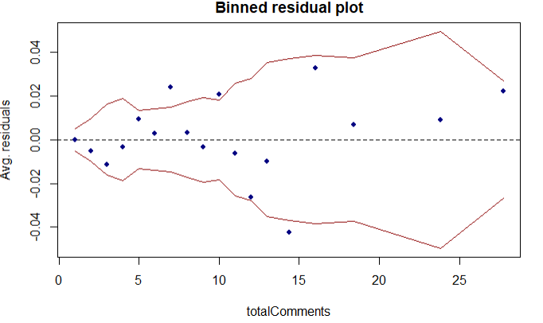
Model Assessment
At least 95% points are within the SE bond
No discernible pattern

Slide 18
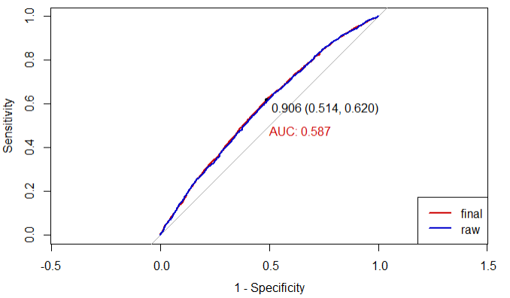
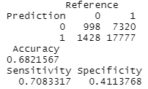
Model validation
Accuracy is 0.682
51.4 percent of classified positive review are indeed positive
62 percent of classified negative review are falsely negative
AUC at 0.587 indicates some diagnostic ability but not ideal

Slide 19


Slide 20
Key findings
Game genre does affect the odds of receiving positive review
RPG games having the highest odds (48% higher)
Action games having the lowest odds (base level)
odds ratio for RPG and Action games within [1.04, 2.06] under 90% confidence level
The association between original price and positive review differs by game genre
Compared with Action games, one unit increase in original price
decrease the odds by 1.57% for Simulation games
decrease the odds by 1.59% for Strategy games
Being offered free is expected to undermine people's review about the game
People tend to value less on free goods (by Mtenga, E. C. L. (2017).)
Odds of positive review for games supporting Russian is generally lower
Russia known for being a region where average price is lower and pirated and smuggled games are rampant
Users holding copyrighted games give negative review to alarm producers about server issue and regional block

Slide 21
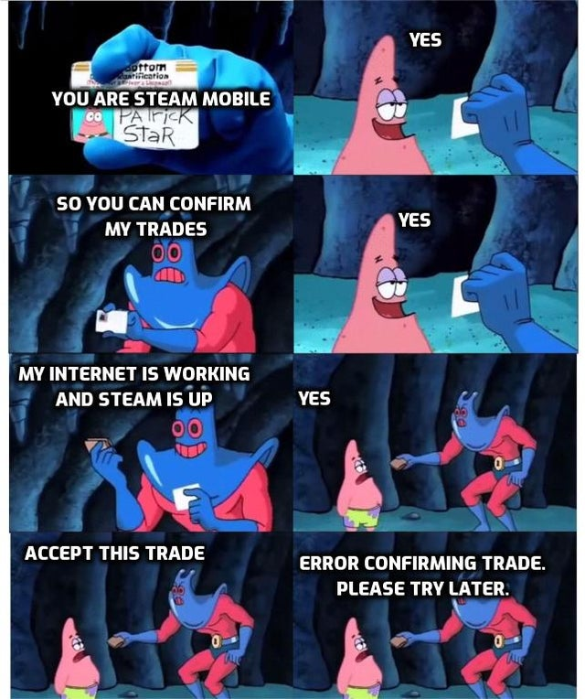
LIMITATION
With almost every column value missing
much information about INDIE games (games produced by independent studios) is excluded
INDIE games are important component of Steam
Analyses are limited to large-company-produced games
Uncontrolled factors like server transition speed
Negative review is given to online games whose server periodically shuts down
People simply give negative review to games when steam restricts them from purchasing e.g. Rocket League

Slide 22



THANK YOU
Wilson Huang
+1 (765) 409-7265
yh297@duke.edu
MIDS-IDS-702

